Slide 1
CAR LICENSE DETECTION VIA OCR (OPTICAL CHARACTER RECOGNITION)
SUBMITTED BY:
BHAVYA THATHERA
20BCS9528

Slide 2
ABSTRACT License Platform Detection is a computer technology that enables us to identify digital images on the platform automatically. Different operations are covered in this system, such as imaging, number pad locations, alphanumeric character truncation and OCR. The final objective of the system is to construct and create efficient image processing procedures and techniques to position a licensing platter on the Open Computer View Library picture. It was used and implemented the K-NN algorithm and python programming language. The technology can be used in different industries such as security, highway speed detection, lighting violations, manuscript documents, automatic charging system, etc.

Slide 3
Use of Modern tools in design and analysis The Modern Tools used in this Project for Design and Analysis is Python. It is a Programming Language. It is used for web development (server-side), software development, mathematics, system scripting and many more. Why Python? Python works on different platforms (Windows, Mac, Linux, Raspberry Pi, etc). Python has a simple syntax similar to the English language. Python has syntax that allows developers to write programs with fewer lines than some other programming languages. Python runs on an interpreter system, meaning that code can be executed as soon as it is written. This means that prototyping can be very quick. Python can be treated in a procedural way, an object-oriented way or a functional way.

Slide 4
Software Requirements: Windows 7 or higher. SQL 2008 or higher. Visual studio 2010, Python Environment. Hardware Components: Processor – i3(Min). Hard Disk – 50 GB. Memory – 3 GB RAM.

Slide 5
Goal: 1. To make people follow traffic rules. 2. To help the crime handling agencies in finding stolen vehicles. 3. To help the government’s pollution checkpoints to keep a proper record of old vehicles which shouldn‘t be used to due to the amount of pollution they are responsible for. 4. To decrease the amount of paperwork done on vehicle-related issues. 5. To make the data processing faster in vehicle-related issues as all the things will be stored in a particular database. Advantages: 1. This project decreases the time consumption of a person. 2. Easy to use. 3. Easy to access the data. 4. Helps for the benefit of society. 5. Might lead to depression in the stealing vehicles. 6. User friendly. 7. And many more.

Slide 6
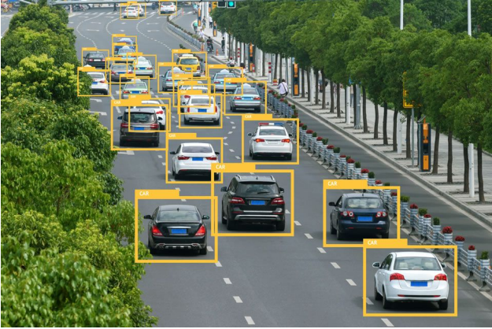
This is how It Will Work:

Slide 7
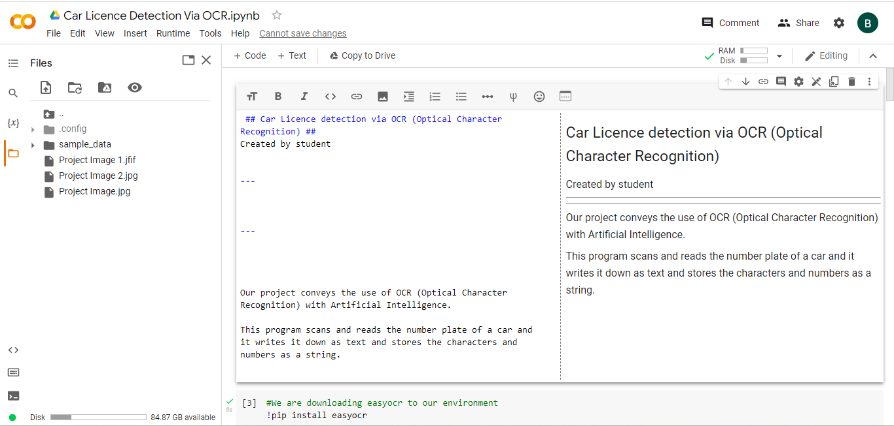
Project Presentation:

Slide 8
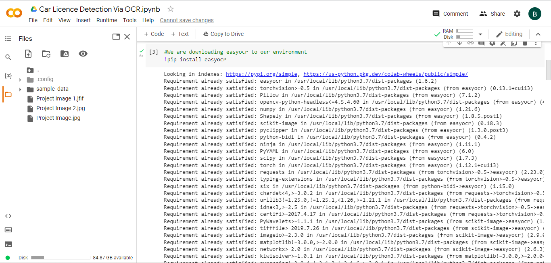
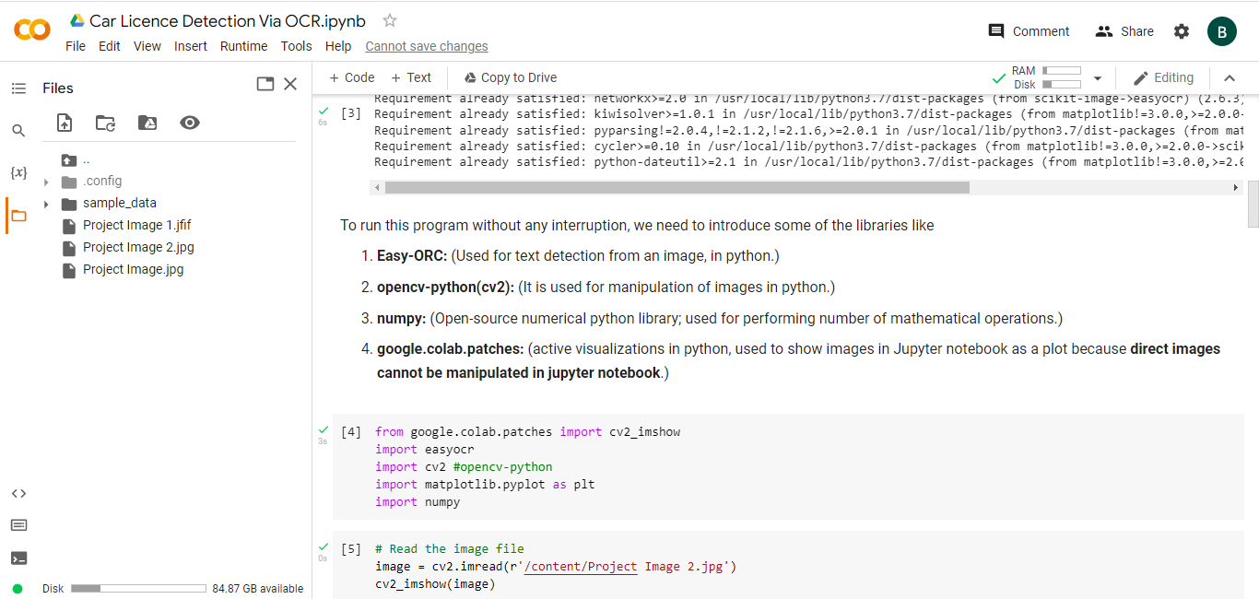

Slide 9
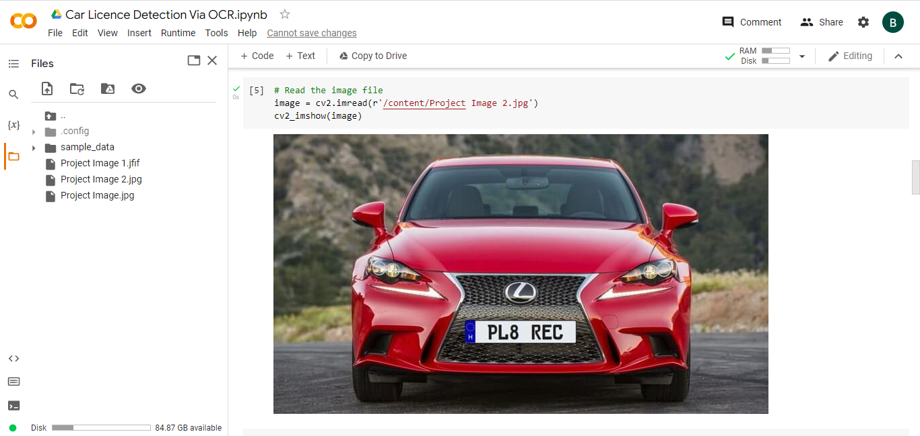
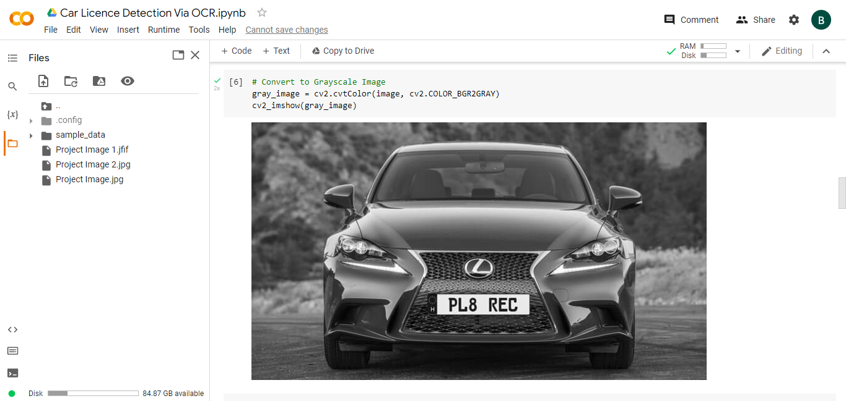

Slide 10
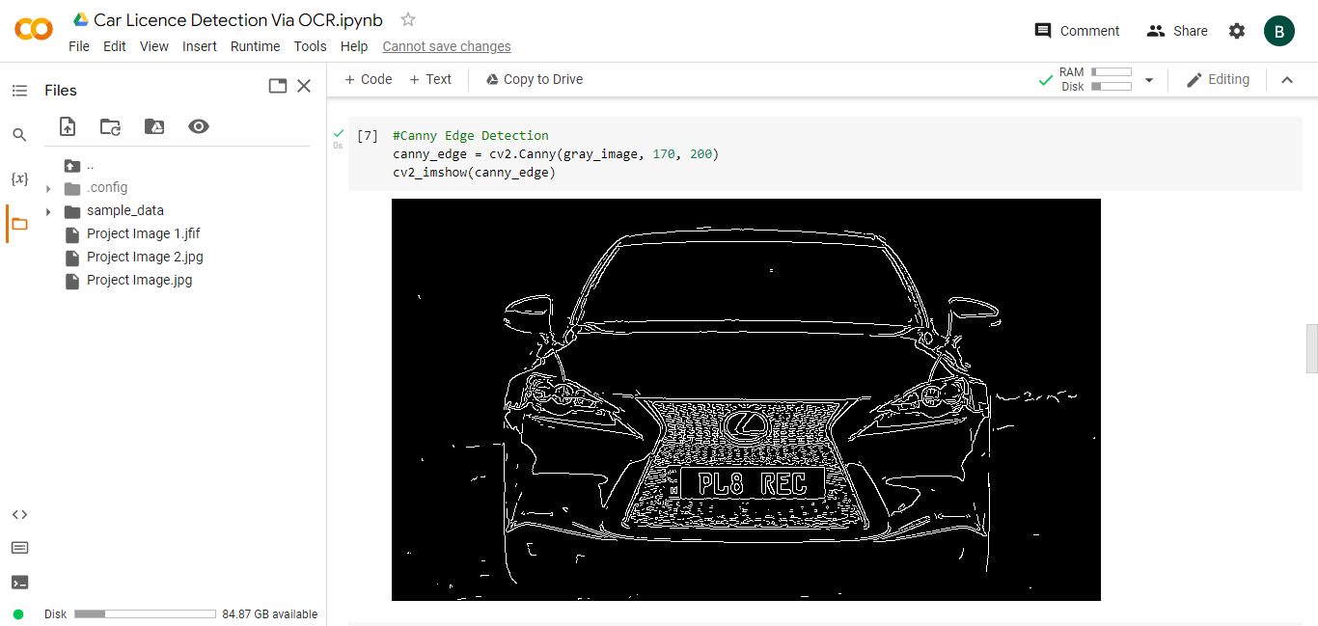
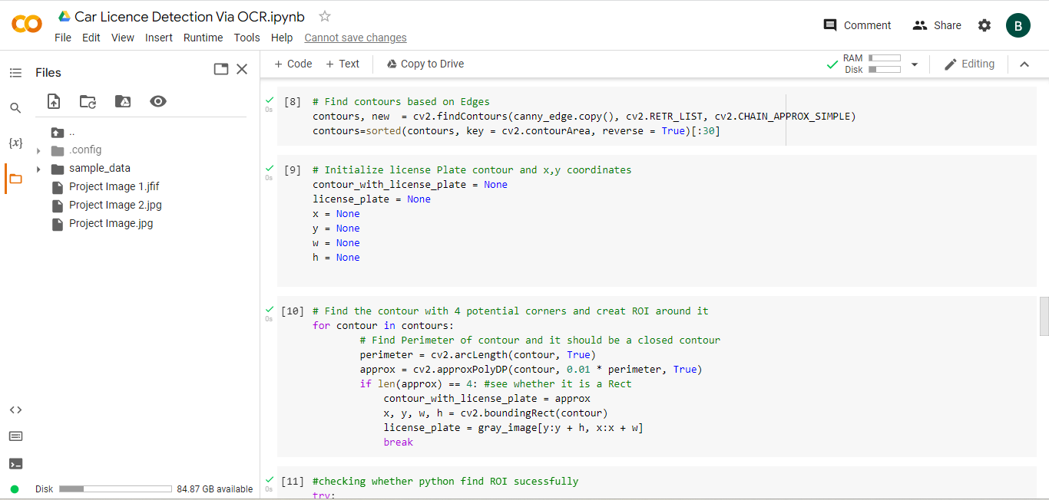

Slide 11
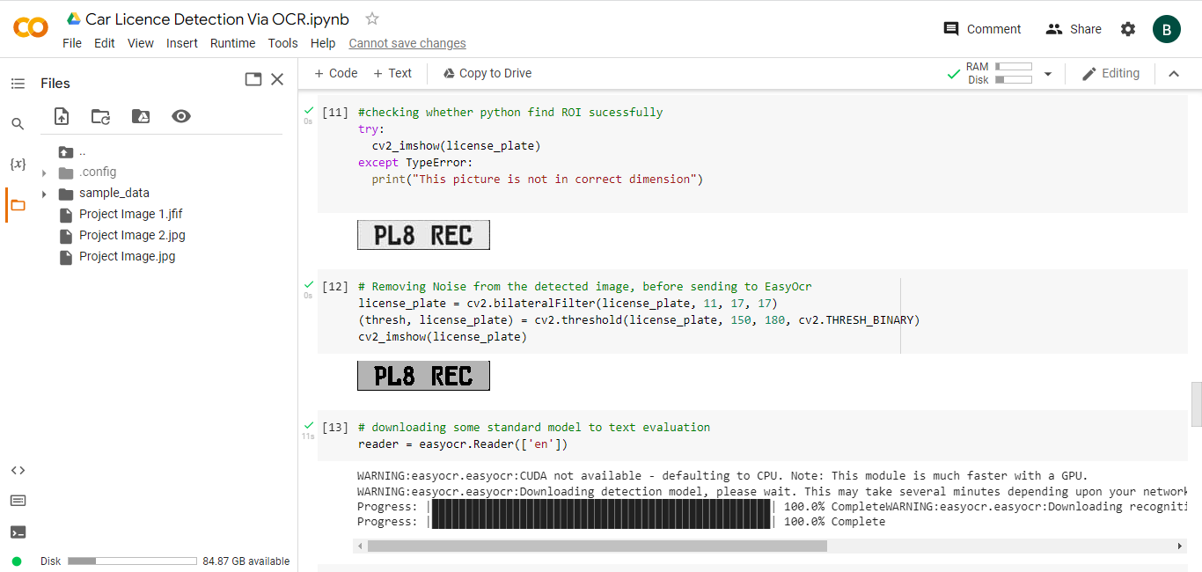
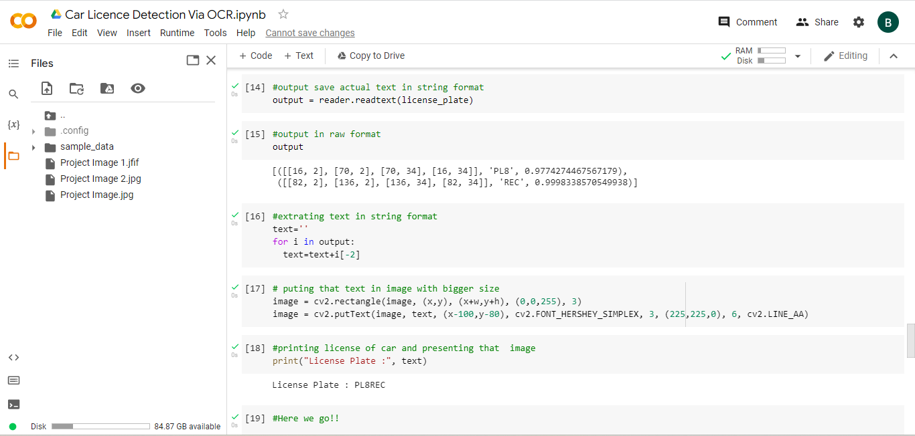

Slide 12
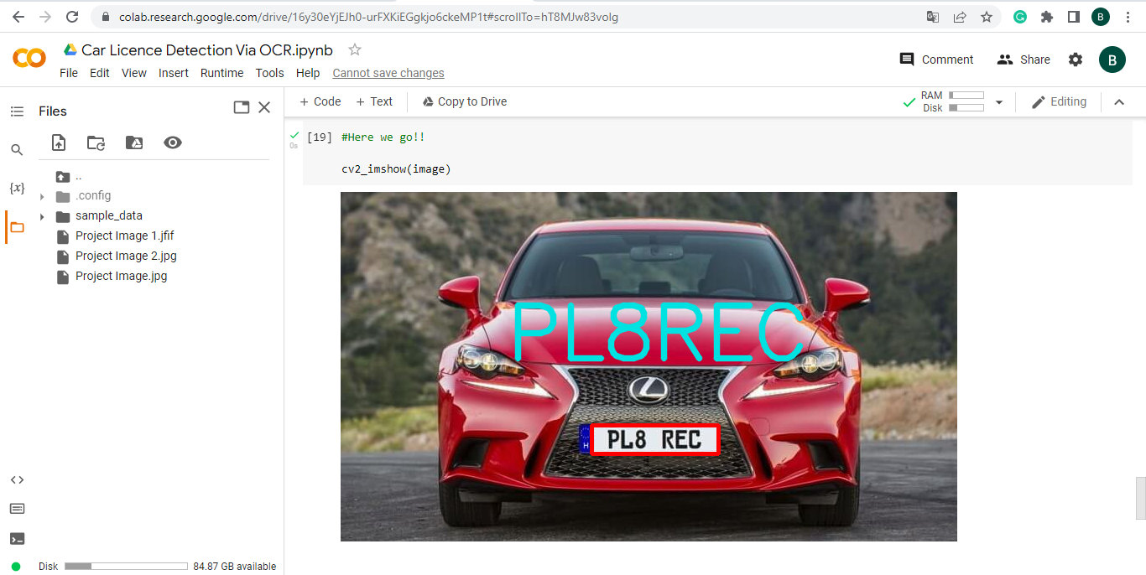
Outcome:

Slide 13
Attainment of stated outcomes ◘ Verifying the ownership of the vehicle (Law Enforcement Purposes). ◘ Used at parking lots for the ease of finding someone’s vehicle. ◘ Useful for faster processing of plate numbers at the service centres or at the Pollution Check Points. ◘ Keeping the track of vehicles passed at the toll points at National and Express Highways. ◘ Security Purposes (Automatic Registration of Vehicle Number Plate via CCTV Footages). ◘ Reduction of the amount of Paperwork.

Slide 14
THANK YOU

